Slide 1

TURNING DATA INTO RETENTION
Telco Customer Churn Prediction
by
Alfriando C Vean

Slide 2

Outline
Background
Data Preparation
Modeling
Recommendation
Industry background & problem statement
Data cleaning & feature engineering before modeling
Finding the best machine learning model using some algorithms & scenarios
Business & model recommendations based on the machine learning result

Slide 3

BACKGROUND

Slide 4

Background
Telco Industry
The telecommunications (telco) industry connects people, businesses, and devices through voice, data, and internet services. It plays a vital role in enabling communication, powering digital transformation, and supporting sectors like finance, education, and healthcare. With rapid advancements in mobile networks and fiber optics. Telcos are evolving from traditional voice service providers to digital service enablers, offering cloud solutions, IoT connectivity, and integrated communication platforms.

Slide 5


Background
Business Flow: What You Need to Know
UNDERSTAND HOW THE BUSINESS WORKS
Customer Acquisition
Service Subscription
Billing
Service Usage

Slide 6

Background
Business Problem: Customer Churn
Customer churn refers to the customers who stop using company’s products or services during a given period.
In the telco industry, churn is a critical metric as it directly impacts revenue and market share.
Understanding and predicting churn helps companies develop targeted retention strategies to maintain customer loyalty.

Slide 7

Background
Key Objective:
A.I. Approach
Build a model to identify customers likely to churn
Use historical data to detect churn patterns early
Support proactive strategies to reduce revenue loss

Slide 8
DATA
PREPARATION

Slide 9
Data Preparation
Dataset Overview:
Historical Data
11 columns
4930 rows
2 numericals
9 categoricals
0 missing
77 duplicates
0 outlier
8 features
1 target
Delete
4853 rows
(cleaned)

Slide 10

Data Preparation
Target
26.5%
Yes (Churn)
No (No Churn)
73.5%
Imbalance

Slide 11

Data Preparation
Preprocesssing
Categoricals
Numericals
Features
Target “Churn”
Robust Scaling*
(Depends on model
One-Hot Encoding
Total 16 Features
*the processing is done in the pipeline

Slide 12

Data Preparation
Data Splitting
20%
Train Data
Test Data
80%

Slide 13
MODELING

Slide 14
Modeling
Main Metric: Recall
True Positive
Recall =
True Positive + False Negative
Why Does It Matter?
Assuming:
Customer stay for 6 months
Monthly Charges is $70
Retention Fees is $20
Category | Loss
False Negative (FN) | $420
False Positive (FP) | $20
Customer Lifetime Value = 6 x $70 = $420
One FN means losing $420 in potential revenue, while one FP only adds $20 in retention costs. This means saving just one FN avoids a loss 21 times larger than one FP. Therefore, a high recall is crucial to ensure fewer truly churned customers are missed.

Slide 15
Modeling
Simple Tuned Model
Model | Recall
Decision Tree | 0.570
Random Forest | 0.496
Logistic Regression | 0.488
XGBoost | 0.484
LigthGBM | 0.484
KNN | 0.473
CatBoost | 0.473
AdaBoost | 0.422
All of the models have underfitting issue. Most probably because the imbalance target.

Slide 16
Modeling
Imbalance Handled
Model | Recall
Decision Tree | 0.864
Logistic Regression | 0.783
XGBoost | 0.760
AdaBoost | 0.752
Random Forest | 0.736
KNN | 0.705
CatBoost | 0.702
LightGBM | 0.643
Eliminated
For further exploration, Decision Tree and Logistic Regression were chosen because they have the best performance and are interpretable models.

Slide 17


Modeling
Advance Tuned Models
Model | Recall
Decision Tree | 0.864
Logistic Regression | 0.783
(No Changes)
Best Model
Consistenly high and more suitable for data dominated by categorical features (non-linear)

Slide 18
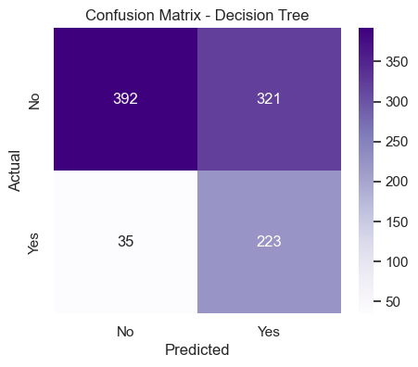
Modeling
Modeling Result
Category | Loss
True Positive (TP) | 223
True Negative (TN) | 392
False Positive (FP) | 321
False Negative (FN) | 35
The Decision Tree model achieved a high recall for the 'Yes' class, with 223 correctly predicted churn cases and only 35 missed cases. This is important because missing churn cases (False Negatives) is more costly for the business than predicting non-churn customers as churn (False Positives).

Slide 19

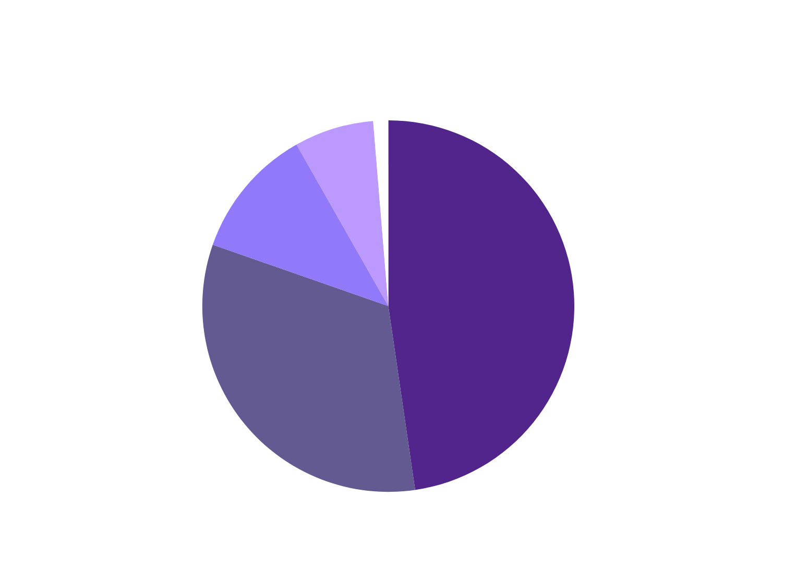
Modeling
Feature Importances
Contracts Features have the most significant importances to the prediction result.

Slide 20
RECOMMENDATION

Slide 21
Recommendation
Business Recommendations
Proactive retention for monthly contract customers: Contract duration is a key churn predictor. Short-term contract customers should be contacted early and offered renewal incentives (discounts, service upgrades).
Special segmentation for Fiber Optic customers: Even premium services show high churn; conduct satisfaction surveys and offer bundled packages to improve loyalty.
Prioritize FN reduction: With 35 FN and an average customer value of $70/month, potential annual loss is 35 × $70 × 6 = $14,700. Reducing FN by 50% could save ~$7,500/year.

Slide 22
Recommendation
When The Model
Can Be Trusted:
Main goal is to identify as many customers as possible who are likely to churn.
Company is willing to accept a high False Positive (FP) rate to reduce False Negatives (FN).
Data used has similar distribution and patterns to the training data (no significant data drift).
Cannot Be Fully Trusted:
Main focus is retention cost efficiency (high FP means retention cost is given to customers who would not churn).
Significant changes occur in products, services, or customer behavior not reflected in the training data.
Model is used far beyond the last data period (e.g., 1–2 years after training) without retraining.

Slide 23

THANK YOU!
Reach me at LinkedIn or GitHub

